Slide 1
Neighbourhood
Planning:

Slide 2
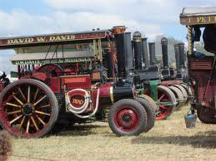
WOODCOTE
A Village:
Halfway between Reading and Wallingford
Entirely within the Chilterns AONB
Comprising some Victorian but mostly modern brick houses
In which most work outside the village and fewer than half of those
employed locally live in the village; and
Probably best known for its famous Rally
Woodcote Rally
An active community
Of some 2500 – 400% larger than in the 1950’s
Who care about Woodcote’s future
Who value the rural look and feel of the village and surrounding countryside;
and
Who feel very strongly that further development should not be allowed.
Dorchester-on-Thames
Tuesday 5th February 2013
www.woodcote-online.co.uk
www.woodcotendp.org.uk

Slide 3
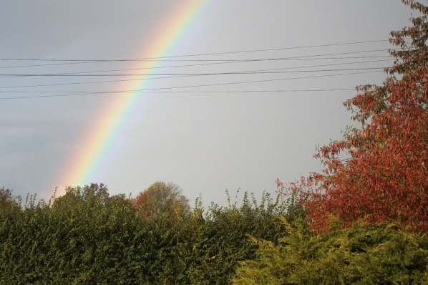
WHAT
DO WE HOPE FOR ?
Rainbow over Woodcote
◆
Better match of development to need
Improved demographic balance
No disruptive development
◆
Much greater local input
Community ownership and buy-in
Recognition that some development can benefit Woodcote
◆
A (more) level playing field
Less sense of powerlessness, less resentment, less conflict
◆
Stability in a longer term binding agreement
No speculative development
Dorchester-on-Thames
Tuesday 5th February 2013
www.woodcote-online.co.uk
www.woodcotendp.org.uk

Slide 4
GETTING STARTED
No precedent
No examples
No guidance
◆
Frontrunner
Create an Advisory Group
Organise around key questions
Create a solid platform
Learn
Broaden
Amend as guidance/regulations emerge
Engage the village
◆
Getting Started
Dorchester-on-Thames
Tuesday 5th February 2013
www.woodcote-online.co.uk
www.woodcotendp.org.uk
Notes:
Stage

Slide 5
ADVISORY GROUP
◆
There’s a lot of work:
Research
Consulting
Communication
Time
Knowledge & Skills
Advisory Group
Others
Parish Council
Village
District Council
◆
◆
Voluntary Advisory Group (15)
Dorchester-on-Thames
Tuesday 5th February 2013
www.woodcote-online.co.uk
www.woodcotendp.org.uk

Slide 6
GETTING STARTED
What is the Housing Need ?
Where might new houses go?
How are possible sites prioritised?
What should new housing look like?
What else should we consider?
Communication & Consultation
How do we comply with planning rules?
Dorchester-on-Thames
Tuesday 5th February 2013
www.woodcote-online.co.uk
www.woodcote-online.co.uk
www.woodcotendp.org.uk
www.woodcotendp.org.uk

Slide 7
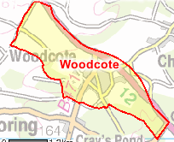
GETTING STARTED
Question/ Work Group
Inputs
Outputs
What is the Housing Need
Parish Plan
Exhibition Inputs
ORCC Housing Need Survey
Housing Need Statement
Where might new houses go?
SODC SHLAA
Landowner Submissions & Data Gathering
Potential Site List
How are possible sites prioritised?
Legislation
Core Strategy
Village Workshops
Selection Criteria
What should new housing look like?
Exhibition Inputs
Local Design Guides
Workshops
- Detail Design Preferences
Design Requirements
What else should we consider?
Living in the Village
How do we comply with planning rules?
Sustainability Assessment
Dorchester-on-Thames
Tuesday 5th February 2013
www.woodcote-online.co.uk
www.woodcote-online.co.uk
www.woodcotendp.org.uk
www.woodcotendp.org.uk

Slide 8
WOODCOTE
Our Approach
Potential Sites
Site Selection Criteria
Prioritised List
Initial Site Allocation
Housing Need
Potential site dBase
SODC SHLAA
Advertising
Selection Grid
Brainstorming
Core Strategy (SA)
Consultation - workshops
Village appraisals and Parish plan
Village meeting
Housing Survey – ORCC form
Dorchester-on-Thames
Tuesday 5th February 2013
www.woodcote-online.co.uk
www.woodcotendp.org.uk

Slide 9
HOUSING SITES
RANKING PROCESS
Site Available?
Rank
Killer Check
Final Test
Using criteria determined by:
need for compliance; and
expressed village preferences.
Dorchester-on-Thames
Tuesday 5th February 2013
www.woodcote-online.co.uk
www.woodcotendp.org.uk

Slide 10
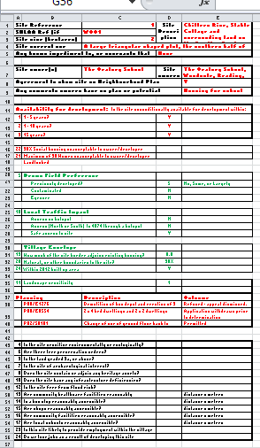
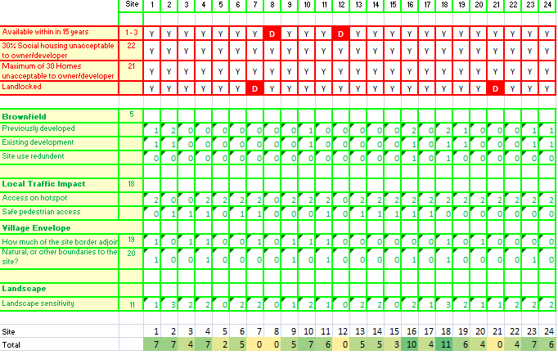
RANKING
SITE DATA
RULES
RANKING
Dorchester-on-Thames
Tuesday 5th February 2013
www.woodcote-online.co.uk
www.woodcotendp.org.uk

Slide 11
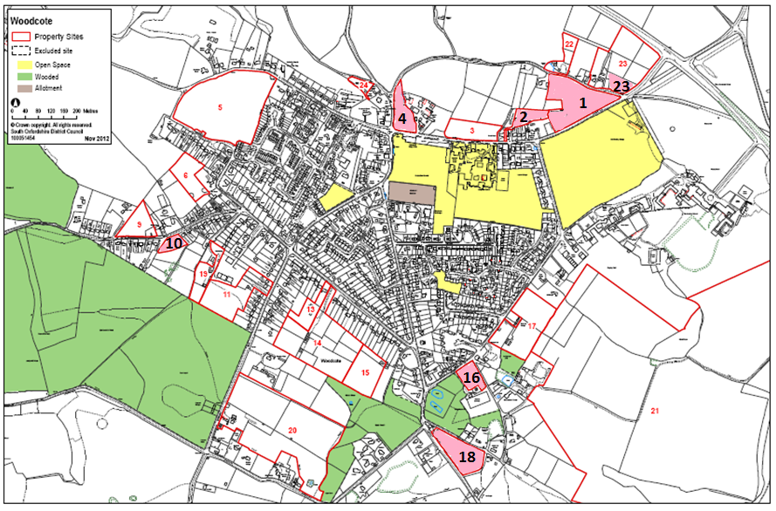
Dorchester-on-Thames
Tuesday 5th February 2013
www.woodcote-online.co.uk
www.woodcotendp.org.uk

Slide 12
HOUSING NEED
❶Parish Plan
❷March Event (>200 i/p)
❸ORCC Survey ~ 35%
❹SODC Housing Dept
❺Estate Agents’ Views
THE NEED
❻Demographics
Dorchester-on-Thames
Tuesday 5th February 2013
www.woodcote-online.co.uk
www.woodcotendp.org.uk

Slide 13
SUSTAINABILITY
ASSESSMENT
◆
The NP must comply with the statutory requirements for Strategic Environmental Assessment (SEA) and Sustainability Appraisal.
◆
A Scoping Report sets out the procedure by which the PC will carry out the SA
⬧
Conflicting advice: needed or not needed?
Little or no guidance: proportionality/scale/depth?
Our position? Play safe - do it
Dorchester-on-Thames
Tuesday 5th February 2013
www.woodcote-online.co.uk
www.woodcotendp.org.uk

Slide 14
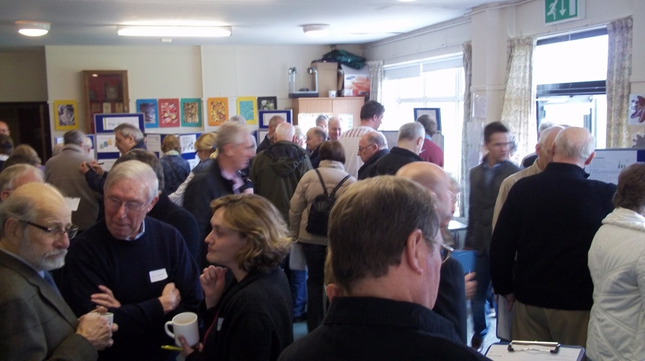
COMMUNICATION
Our Approach
Woodcote NP Public Meeting
Awareness
Acceptance,
Interest,
Engagement
Website
E-mail
Village magazine
Local press
Frequent general communication
Examination
Consultation
Statement
Consult, consult, consult
Open meetings,
Open workshops
.....
Before......
After
Referendum
No surprises
Dorchester-on-Thames
Tuesday 5th February 2013
www.woodcote-online.co.uk
www.woodcotendp.org.uk

Slide 15
WHAT NEXT?
Site Identification
Site Selection Criteria
Housing Need
Draft numbers and sites
Village consultation
Draft plan
Parish Council Review
Annual Parish Meeting
District Council Review
Public Examination
Village Referendum
Design
Living in the Village
Sustainability Analysis
Early February 2013
Dorchester-on-Thames
Tuesday 5th February 2013
www.woodcote-online.co.uk
www.woodcote-online.co.uk
www.woodcotendp.org.uk
www.woodcotendp.org.uk

Slide 16
EARLY LESSONS
In the beginning......
Remember
Have a clear sense of desired outcomes
Get a road map early
Get a budget together
Create and implement a communication plan
Have a community mandate
Identify an engaging entry point
Proceed in small steps ⇨ community engagement ;and
⇨ buy-in and learning as you go
There’s help out there – ORCC, ODO ....
The Examination - document evidence as you go along
The Referendum – consult and communicate continuously
The Sustainability Assessment – start the scoping report asap
To watch for ‘Scope Creep and ‘hijackers’
It’s a community plan – not yours!
Dorchester-on-Thames
Tuesday 5th February 2013
www.woodcote-online.co.uk
www.woodcote-online.co.uk
www.woodcotendp.org.uk
www.woodcotendp.org.uk

Slide 17
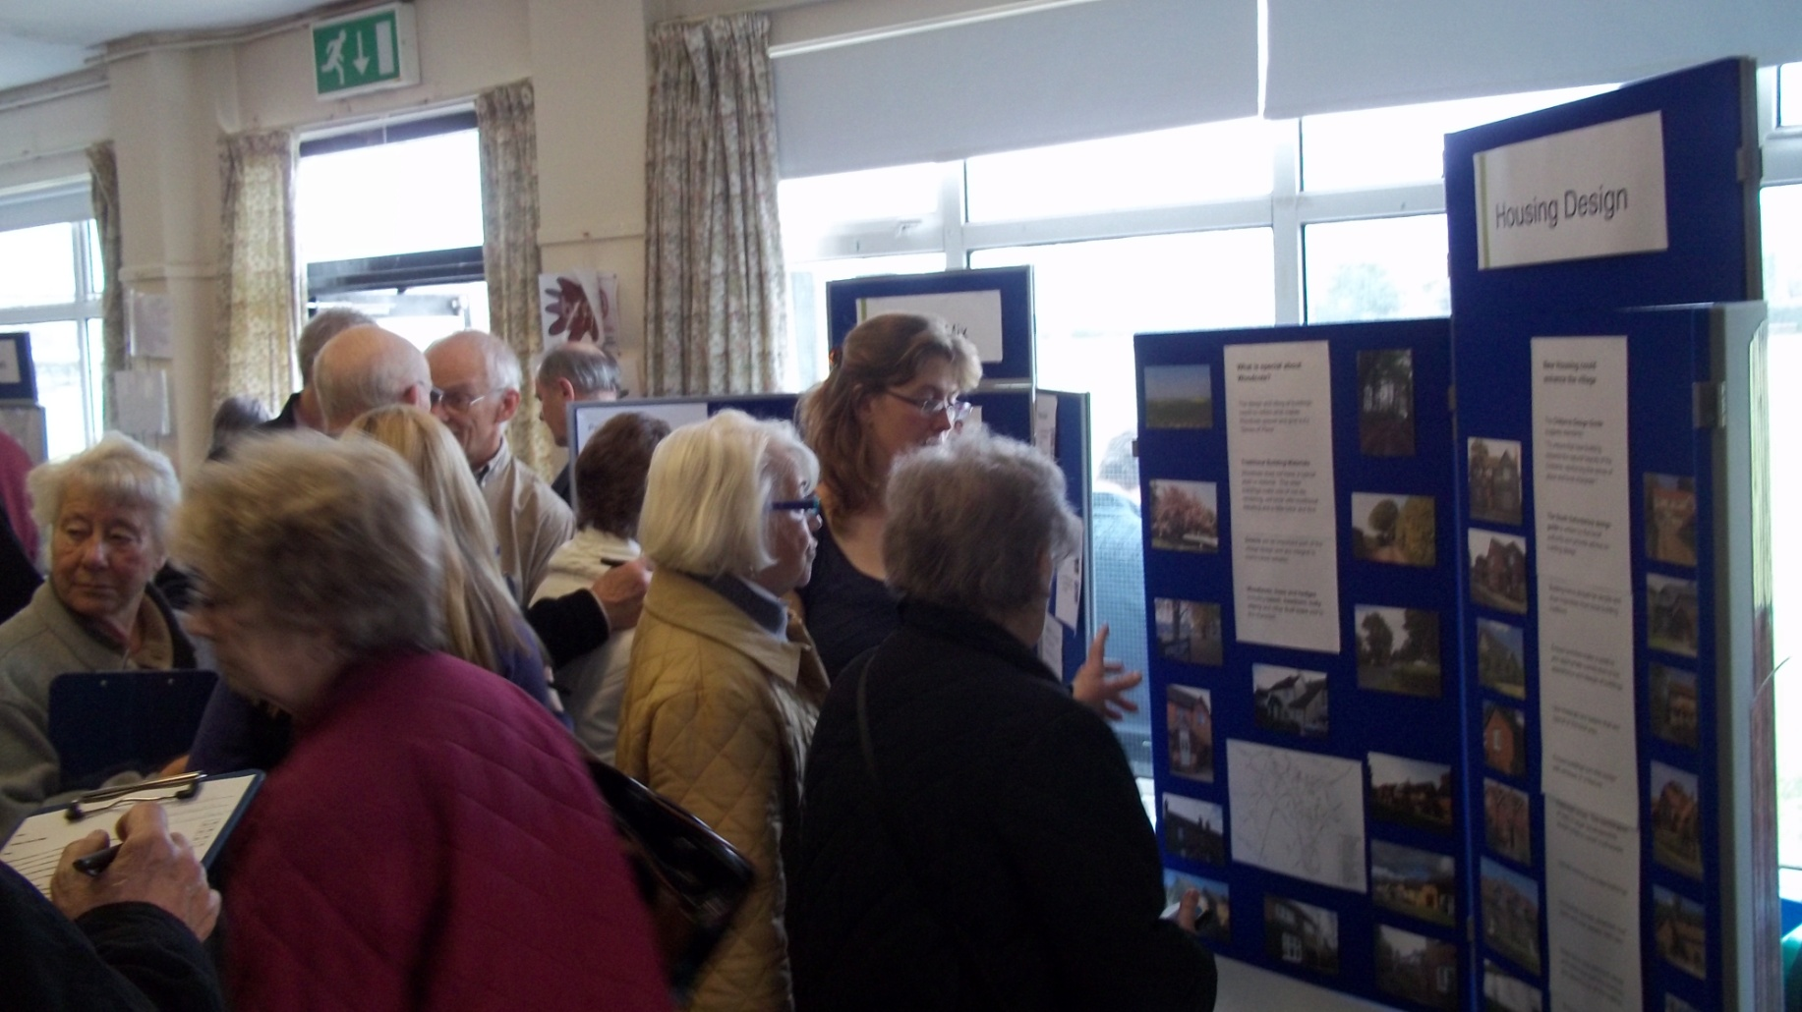
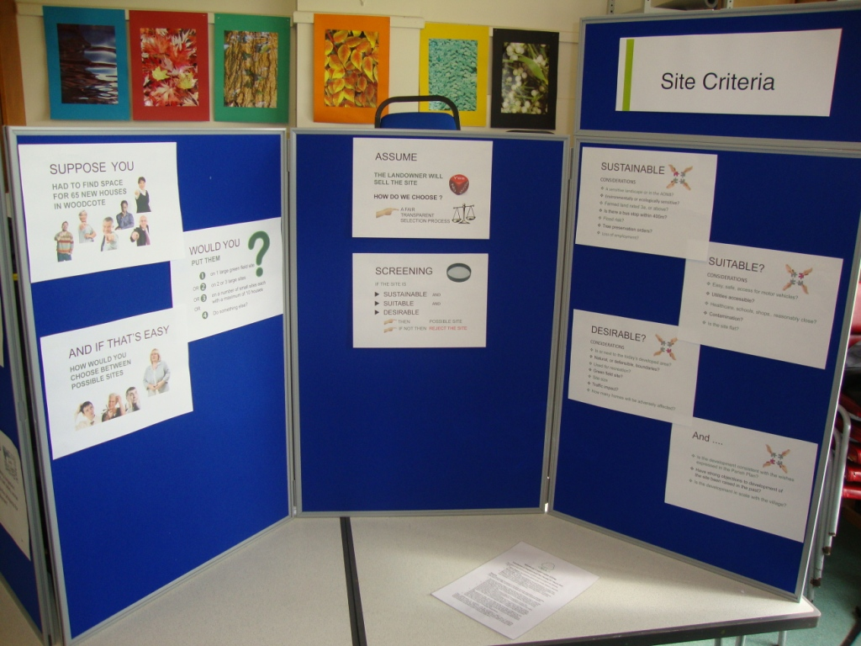
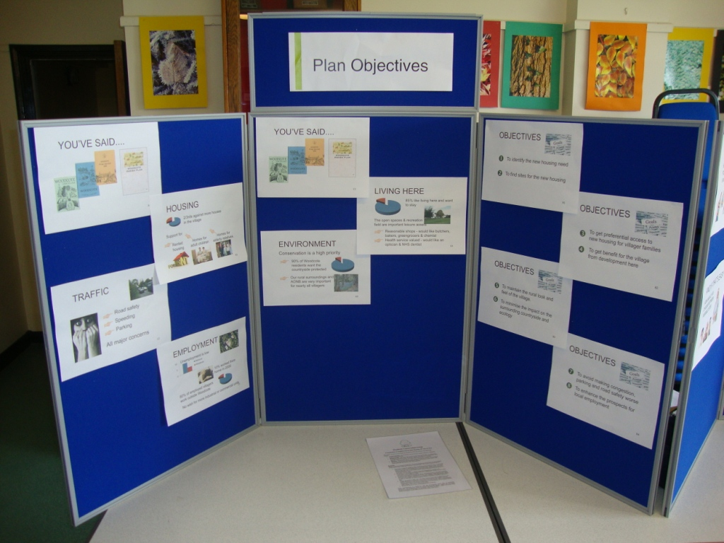
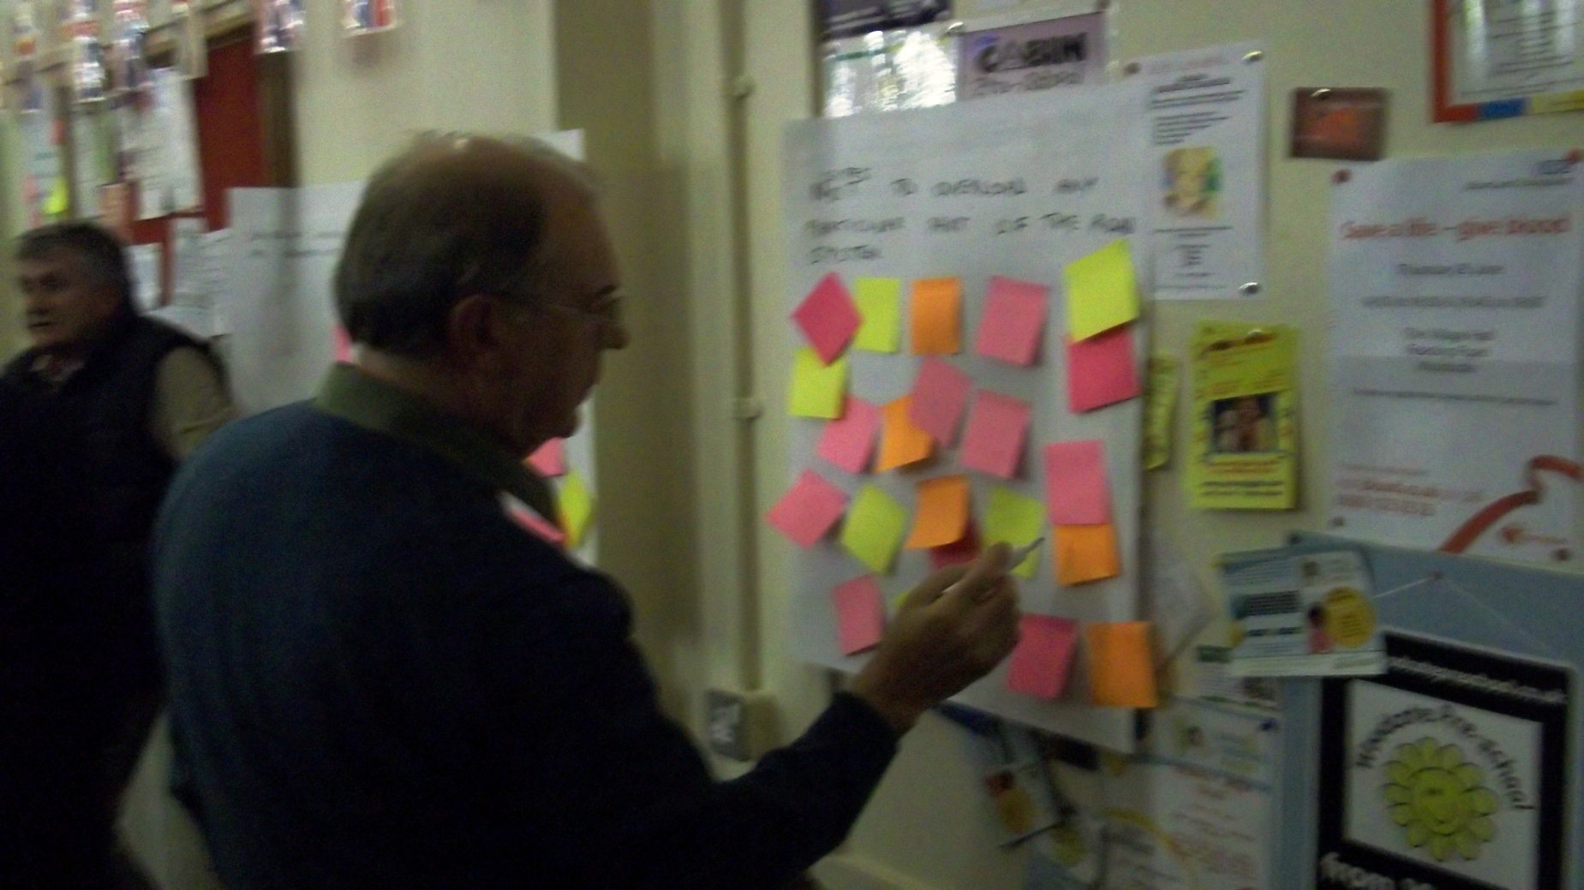
www.woodcotendp.org.uk
Dorchester-on-Thames
Tuesday 5th February 2013
www.woodcote-online.co.uk
www.woodcotendp.org.uk

Slide 19
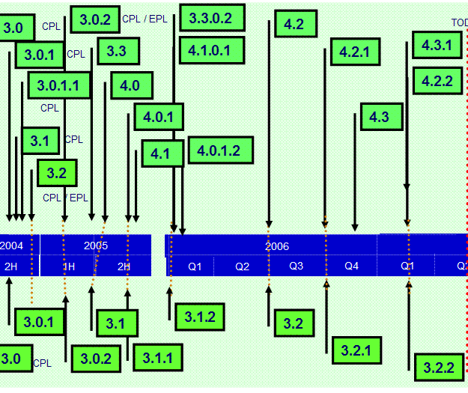
TIMING
ROAD MAP
Dorchester-on-Thames
Tuesday 5th February 2013
www.woodcote-online.co.uk
www.woodcotendp.org.uk

Slide 20
Volunteer Committee Formed
Work Streams Identified
Public Drop In Event – Stands and Survey
Volunteers Draft Sites & Numbers
Public Townhall – Speakers
Test Site Proposals & Numbers
Volunteers to Review all findings & Draft Conclusions
6 weeks – Parish consultation - Exhibition
Present to PC
Present to SODC
Final Plan Presentation
6 weeks – Formal Public Consultation
DOE - Examination
Referendum
Site Identification
Landowner Submissions & Data Gathering
Site Selection Criteria
Workshops
– Validate Criteria
Housing Need
ORCC Housing Need Survey
Design
Volunteers source Best Practice Design
Workshops
- Detail Design Preferences
Living in the Village
Scope - Detail Preferences
Sustainability Analysis
Conduct Sustainability Analysis
Documents
Scoping Report - SA
Core Strategy Published
1st Draft NDP
Final SA
2nd Draft NDP
Final NDP
We are here
Sept 2011 | Oct 2011 | Nov 2011 | Dec 2011 | Jan 2012 | Feb 2012 | Mar 2012 | Apr 2012 | May 2012 | Jun 2012 | Jul 2012 | Aug 2012 | Sept 2012 | Oct 2012 | Nov 2012 | Dec 2012 | Jan 2013 | Feb 2013 | Mar 2013 | Apr 2013 | May 2013 | June 2013 | July 2013 | Aug 2013 | Sept 2013 | Oct 2013
Sub Groups Assigned 2nd Nov
1st Public Event 10th Mar 2012 Approx 400 attended
Deadline for Landowner submissions 16th July
Workshops scheduled for Sat 7th Jul and Tues 10th Jul Eve
Special PC Meeting 5th Sept 11 – Volunteers requested First Meeting for Volunteers 22nd Sept 11
Annual Parish Meeting – April / May
ORCC Survey distributed by start of June
ORCC Survey submission by 18th Jun

Slide 21
SITE RECORD
Site Details
Site Reference |  |  | Site Description
SHLAA Ref (if applicable)
Site size (hectares)
Site current use
Any known impediment to, or covenants that could affect, development?
Site owner(s) |  |  | Site owners address
Agreement to show site on Neighbourhood Plan
Any comments owners have on plan or potential community gain
Dorchester-on-Thames
Tuesday 5th February 2013
www.woodcote-online.co.uk
www.woodcotendp.org.uk

Slide 22
Availability for development: Is the site unconditionally available for development within:
1 |  | 1 - 5 years?
2 |  | 1 - 10 years?
3 |  | 15 years?
22 |  | 40% Social housing unacceptable to owner/developer
21 |  | Has the landowner agreed to partial development of the site?
 |  | Does the landowner own the access from the site to the highway?
5 |  | Brown Field Preference
 |  | Previously developed?
 |  | Existing buildings on the site?
 |  | Site use redundent?
18 |  | Local Traffic Impact
 |  | Access on hotspot
 |  | Safe pedestrian access?
 |  | Village Envelope
19, 24 |  | How much of the site border adjoins existing housing?
20 |  | Natural, or other boundaries to the site
11 |  | Landscape sensitivity
Planning Application Number |  |  | Description |  | Outcome
Dorchester-on-Thames
Tuesday 5th February 2013
www.woodcote-online.co.uk
www.woodcotendp.org.uk

